Slide 1
Version Control Systems

Slide 2
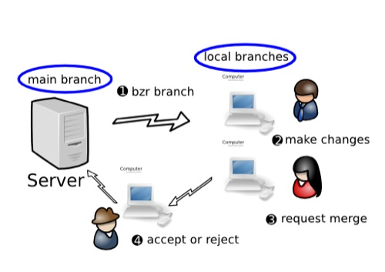
Version Control Systems(VCS)
A version control system allows programmers to keep track of every revision of all source code files
Version control is important to keep track of changes and keep every team member working off the latest version.
The main element of the version control system is the repository, a database or directory which contains each of the files contained in the system.
A programmer can pick a point at any time in the history of the project and see exactly what those files looked like at the time.
Latest version of any file can be retrieved from the repository.
Changing a file will not unexpectedly overwrite any previous changes to that file; any change can be rolled back.

Slide 3
Version Control Systems(VCS)
Version Control Systems (VCS) have seen great improvements over the past few decades and some are better than others.
VCS are sometimes known as SCM (Source Code Management) tools or RCS (Revision Control System).
Some popular version control systems are Git (distributed), Mercurial (distributed), and Subversion (centralized).

Slide 4
Purpose of Version Control
Version control enables multiple people to simultaneously work on a single project.
integrates work done simultaneously by different team members
Version control gives access to historical versions of your project.

Slide 5
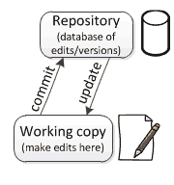
Repositories and working copies
Version control uses a repository (a database of changes) and a working copy where you do your work.
A repository is a database of all the edits to, and/or historical versions (snapshots) of, your project.
Your working copy (sometimes called a checkout) is your personal copy of all the files in the project.

Slide 6
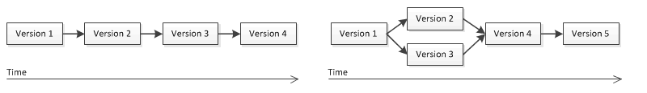
Branching in version control
In the simplest case, the database contains a linear history: each change is made after the previous one.
Another possibility is that different users made edits simultaneously (this is sometimes called “branching”).
version history splits and then merges again.

Slide 7
Version Control Systems(VCS)
There are two common models for version control systems
In a copy-modify-merge system, multiple people can work on a single file at a time.
When a programmer wants to update the repository with his changes, he retrieves all changes which have occurred to the checked out files and reconciles any of them which conflict with changes he made before updating the repository.
In a lock-modify-unlock system, only one person can work on any file at a time.
A programmer must check a file out of the repository before it can be modified. The system prevents anyone else from modifying any file until it is checked back in.
On large projects, the team can run into delays because one programmer is often stuck waiting for a file to be available.

Slide 8
INDUSTRY JARGON
Repository (repo): Database where files are stored
Server: The computer storing the repository
Client: The computer connecting to the repository
Working Copy: Your local directory of files
Trunk / Main: Master location for code in the repository
Head: The latest revision in the repository

Slide 9
BASIC ACTIONS
Add: Place a file under version control
Check in: Send local changes to the repo
Check out: Download from a repo to your working copy
Ignore: Allows files to exist in your working copy but not in the repo
Revert: Throw away your working copy and restore last revision
Update / Sync: Update your working copy to the latest revision

Slide 10
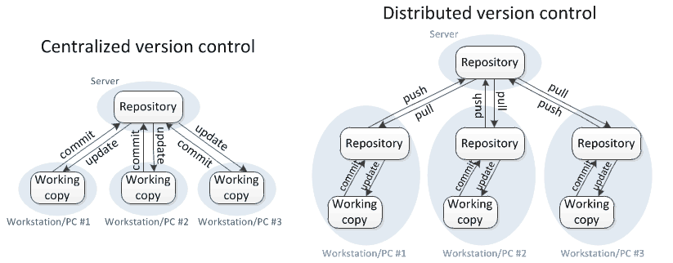
Centralized Vs Distributed VCS

Slide 11
Centralized Version Control System
server and a client
server is the master repository which contains all of the versions of the code
To work on any project, firstly user or client needs to get the code from the master repository(take an update from the master repository)
After making the changes ,need to commit those changes straight forward into the master repository.
There will be just one repository and that will contain all the history or version of the code and different branches of the code.
Platforms: SVN,ClearCase etc.
Software:Tortoise SVN,SmartSVN

Slide 12
Distributed Version Control System
every single developer or client has their own server and they will have a copy of the entire history or version of the code and all of its branches in their local server or machine
every client or user can work locally and disconnected which is more convenient than centralized source control

Slide 13
Distributed Version Control System….
when you start working on a project,
you clone the code from the master repository in your own hard drive,
then you get the code from your own repository to make changes
after doing changes, you commit your changes to your local repository
At this point your local repository will have ‘change sets‘ but it is still disconnected with master repository (master repository will have different ‘sets of changes‘ from each and every individual developer’s repository)

Slide 14
Distributed Version Control System…
To communicate with it, you issue a request to the master repository and push your local repository code to the master repository.
Getting the new change from a repository is called “pulling” and merging your local repository ‘set of changes’ is called “pushing“.
Platforms: GIT,mercurail,Bazaar
Softwares:GITHub,GITLab,bBtbucket etc.

Slide 15
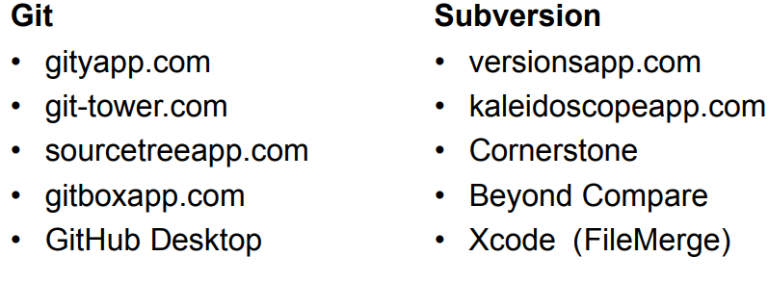
TOOLS & APPS - MAC

Slide 16
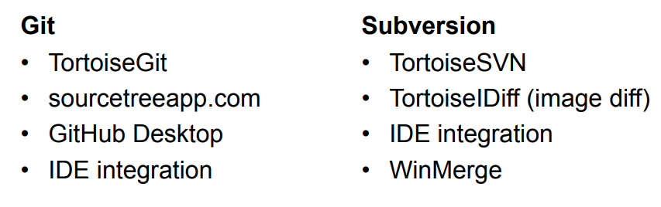
TOOLS & APPS - WIN

Slide 17

Subversion(SVN)
Apache Subversion, abbreviated as SVN aims at to be a best-matched successor to the widely used CVS
Has a benefit of good GUI tools like TortoiseSVN.
Supports empty directories.
Have better windows support as compared to Git.
Easy to set up and administer.
Integrates well with Windows, leading IDE and Agile tools.
Free and opensource
Official website: https://subversion.apache.org/

Slide 18
Subversion(SVN)
SVN checkout
Downloads repository contents to a local folder
Update
Merges new changes from repository to the local working copy. Updates before every commit are important .
Commit
Merges changes from local copy to SVN repository.
Resolved
Tells SVN that the conflicted file is now OK.
Add
Schedules new file to be saved to repository with next commit.
Delete
Schedules file to be deleted from repository with next commit. Accidental deletes can be recovered.
Revert
Undoes all changes to the local copy since last commit. Throw away the changes and start over.
Log
Shows log of changes sorted by date

Slide 19
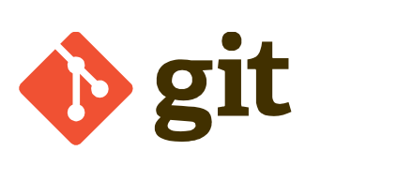
GIT
Git is one of the best version control tools that is available in the present market.
Super-fast and efficient performance.
Cross-platform
Code changes can be very easily and clearly tracked.
Easily maintainable and robust.
Offers an amazing command line utility known as git bash.
Also offers GIT GUI where you can very quickly re-scan, state change, sign off, commit & push the code quickly with just a few clicks.
Open Source and free
Official website : https://git-scm.com/

